Slide 1
CERES
By Team 104
Software Engineering
Instructor - Dr. Hyo Jung Song
Notes:
Khyo

Slide 2
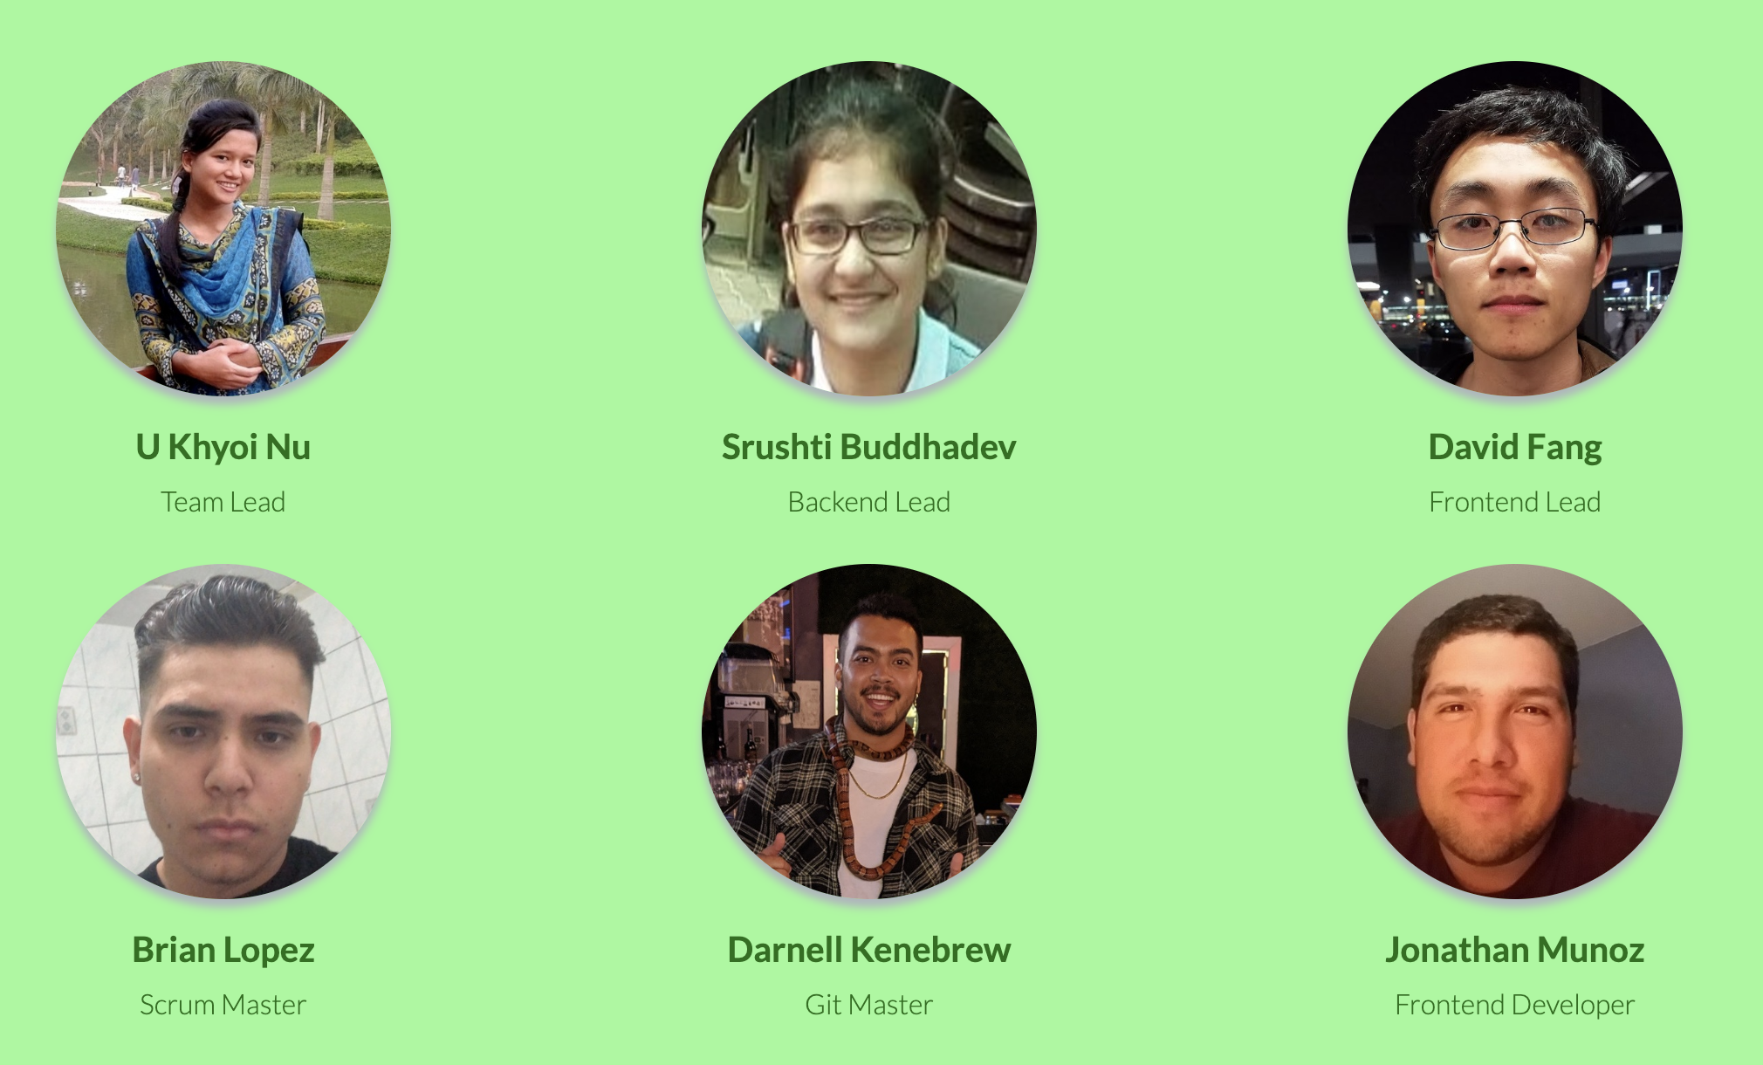
Notes:
Khyo

Slide 3
Objectives
What is Ceres?
Motivation
Key functionalities
Unique feature
Credibility of data
Beta Testing
Demo
Takeaway
Notes:
Khyo

Slide 4
What is Ceres?
Notes:
DARNELL

Slide 5
Why We created Ceres?
What we wanted to solve?
How We went about doing so?
Notes:
DARNELL

Slide 6
Key Functionalities
Signup-Signin
Receipt Upload
Inventory
Shopping List
Recipes based on inventory

Slide 7
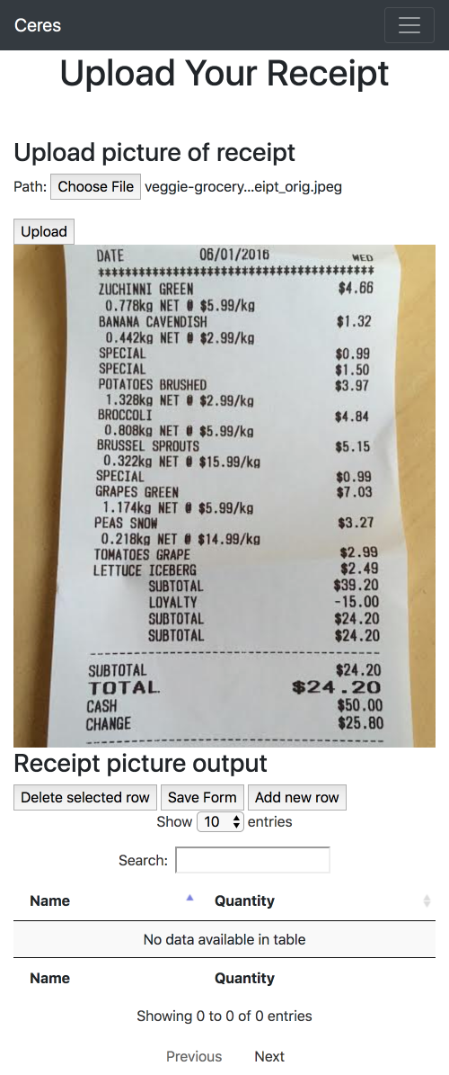
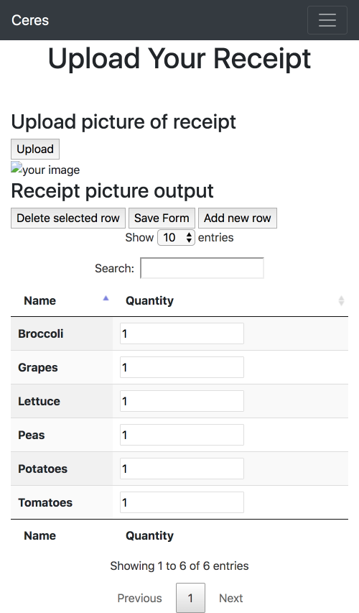
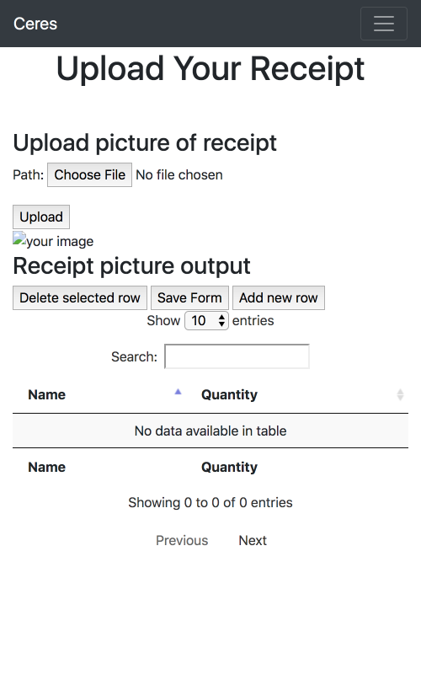
Receipt Upload
Notes:
Srushti

Slide 8
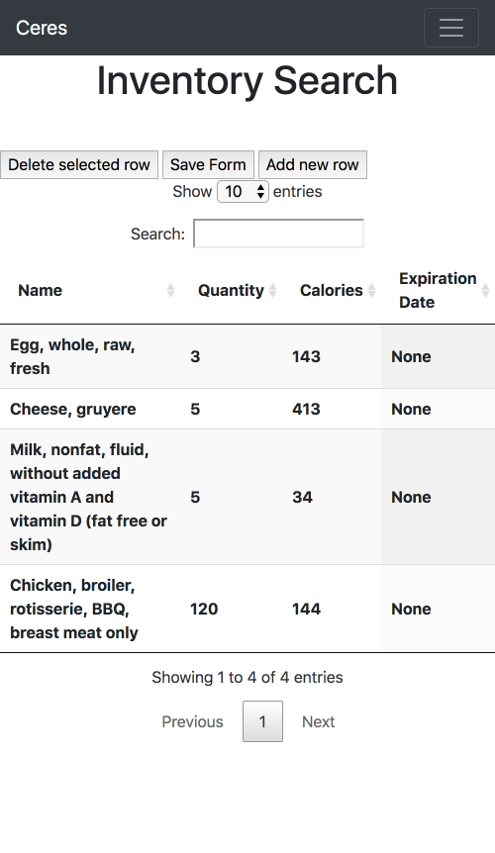
Inventory
Notes:
Jonathan

Slide 9
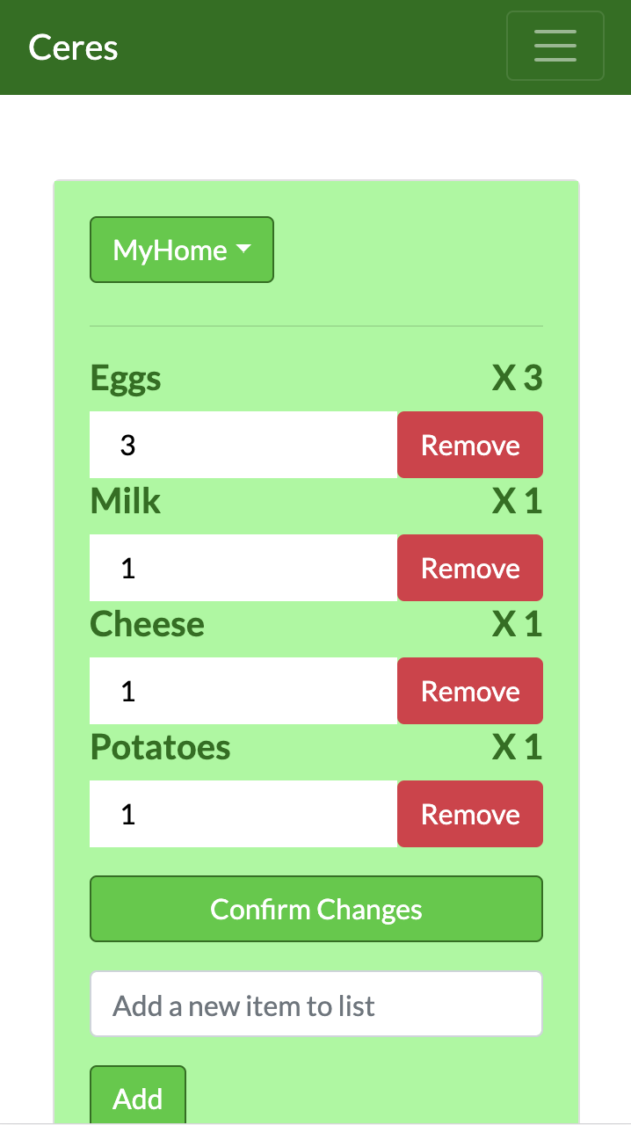
Shopping List
Notes:
Jonathan

Slide 10
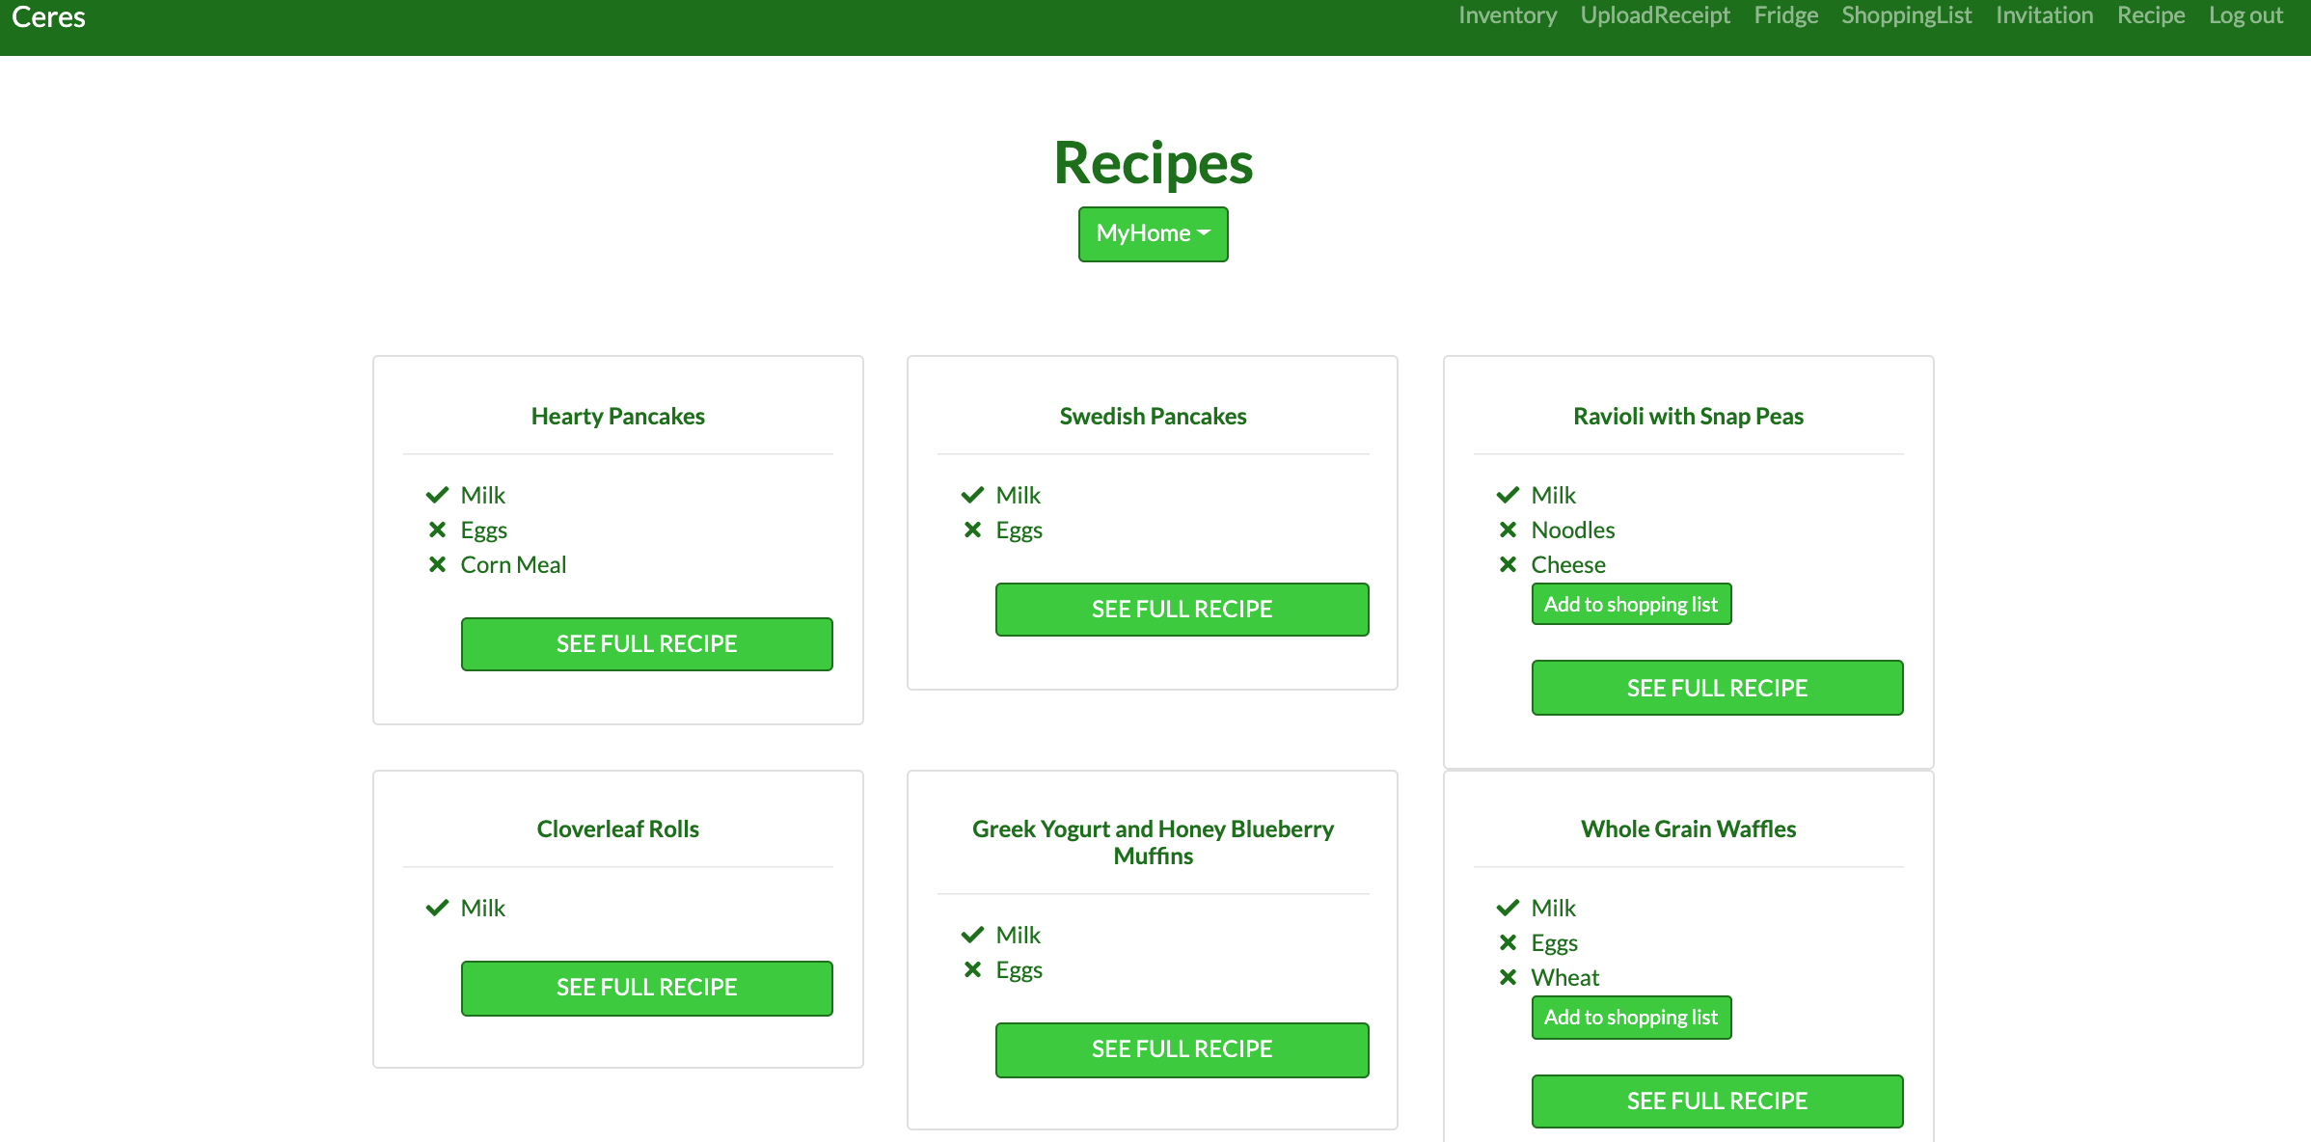
Recipes
Notes:
Khyo

Slide 11
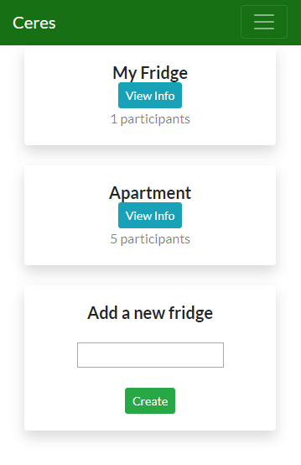
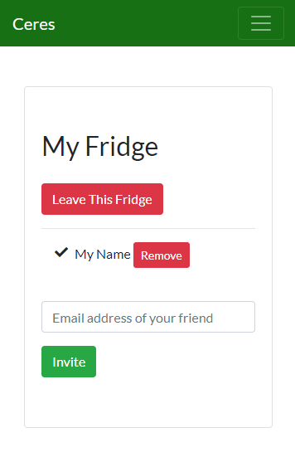
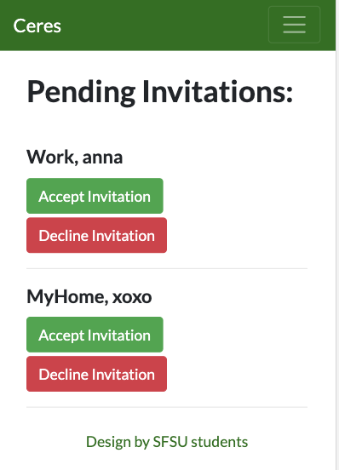
Unique Feature - Fridges
Notes:
David

Slide 12
Credibility of data
Food Data: The nutrition facts on our database are driven by the USDA Agricultural Research Service (ARS) Nutrition Facts Database.
Data is carefully vetted by the USDA ARS, with documentation provided on how this data is
Over 100+ recipes so you can make sure dinner will always be served
Notes:
DARNELL

Slide 13
Beta Testing (user Experience)
Beta Tester: Cousin
Spent a week with the product
Feedback:
“I enjoyed the product, but it has its flaws, I noticed the receipt upload feature wasn’t working correctly.”
“The recipe page was also displaying recipes for items I didn’t currently own, so I thought it would be better if it showed the recipes based on items I did own.”
“If this were a real product you made I would fully support you and this is something I could actually see myself using.”
Notes:
Brian

Slide 14
Beta Testing(Engineer response)
Useful Feedback
Sets the team on a path guided by user experience
Positives of Beta Testing:
Useful feedback that can motivate progress
Help engineers identify problems they were not aware of
Fix things testers have issues with
Negatives of Beta Testing:
Can’t please everyone
Engineers cannot control the testing as it is managed by users
Overall a positive learning experience

Slide 15
Demo

Slide 16
Takeaway
New Framework
Time Management
Team Coordination
Adapt to unforeseen complications

Slide 17
Thank You

